Slide 1
FINAL PROJECT
-TADIBOYINA JAHNAVI LAKSHMI

Slide 2
KEY LOGGER AND
SECURITY

Slide 3
AGENDA
 | BASIC KEY LOGGER DEFINITION
 | EXPLAINATION ABOUT DIFFERENT TYPES OF KEY LOGGERS
 | KNOWING THE PROBLEM STATEMENT
 | OVERVIEW OF PROJECT
 | WHO ARE END USERS?
 | INTRODUCING THE SOLUTION
 | THE WOW IN YOUR SOLUTION
 | MODELLING AND RESULTS

Slide 4
DEFINITION :
A keylogger, sometimes called a keystroke logger, is a type of surveillance technology used to monitor and record each keystroke on a specific device, such as a computer or smartphone. It can be either hardware- or software-based. The latter type is also known as system monitoring software or keyboard capture software.

Slide 5
WHY KEY LOGGER IS USED?
Keyloggers are often used as a spyware tool by cybercriminals to steal personal identified information , login credentials and sensitive enterprise data .
That said, some uses of keyloggers could be considered ethical or appropriate in varying degrees. For instance, keyloggers can also be used for the following reasons:
By employers to observe employees computer activities.
By parents to supervise their children's internet usage.
By device owners to track possible unauthorized activity on their devices.
By law enforcement agencies to analyze incidents involving computer use.

Slide 6
TYPES OF KEY LOGGER
There are two types of key loggers
software key logger
hardware keylogger
A software keylogger is a form of malware that infects your device and, if programmed to do so, can spread to other devices the computer comes in contact with.
While a hardware keylogger cannot spread from one device to another, like a software keylogger, it transmits information to the hacker or hacking organization, which they will then use to compromise your computer, network, or anything else that requires authentication to access.

Slide 7
PROJECT OVERVIEW
Learning about the key logger.
Creating a solution for the arising problem.
Key loggers also known as keystroke loggers, may be defined as the recording of the key pressed on a system and saved it to a file, and the that file is accessed by the person using this malware. Key logger can be software or can be hardware.

Slide 8
WHO ARE END USERS ?
End users
Casual end users
Individual end users.
Parametric end users
Highly Sophisticated End Users
When it comes to technology, end users can be grouped into four distinctive categories: casual, parametric, highly sophisticated, and individual users. Each type of end user has a unique set of characteristics that influences their technology usage patterns and requirements.

Slide 9
Casual End Users: These are individuals who use technology occasionally and typically rely on basic features and applications to accomplish their tasks.
Parametric End Users: This group comprises individuals who have some technical proficiency and require specific features and functionalities to perform their tasks.
Highly Sophisticated End Users: This category includes individuals who require advanced technical skills and expertise to use complex and sophisticated software.
Individual Users: These are individuals who use technology on a personal level for entertainment, social media, and communication purposes.

Slide 10
PROBLEM STATEMENT
keyloggers is that malicious users can identify and exploit your personal information. The following examples illustrate some of the risks of a keylogger attack: Hackers can steal credit card information and make unauthorized purchases.
When a keylogger is active, it silently captures all keystrokes entered by the user.
It can track everything you type, including login credentials, emails, and other sensitive data.
Keyloggers can be installed through malware, software bugs, or even hardware devices.

Slide 11
PROTECTION MEASURES
Be cautious: Avoid downloading software from untrusted sources, especially when using public Wi-Fi.
Regularly scan for malware: Use reliable antivirus software to detect and remove keyloggers.
Monitor your accounts: Regularly check your bank statements and other accounts for any suspicious activity.
Use strong, unique passwords: This makes it harder for keyloggers to capture sensitive information.

Slide 12
SIGNS THAT THERE IS A KEYLOGGER IN MY DEVICE !
Detecting a keylogger on your device can be crucial for maintaining your privacy and security.
1.Performance Changes: If your device suddenly becomes slow, lags, or experiences unusual resource usage even during basic tasks, it could indicate the presence of a keylogger or other malicious software.
2. Unfamiliar Processes in Task Manager or Activity Monitor: Open your device's Task Manager (Windows) or Activity Monitor (Mac) to see if there are any unfamiliar processes running that are consuming excessive resources. Look for processes with unusual or random names.
3. Review Installed Programs/Apps: Check the list of installed programs or applications on your device. Look for any unfamiliar or suspicious software that you didn't install yourself.
4. Unusual Network Activity: Monitor your network activity using your device's built-in network monitoring tools or third-party software. If you notice a lot of data being sent to unfamiliar destinations, it could indicate the presence of a keylogger.
5. Check for Physical Devices: If you suspect a hardware keylogger, physically inspect your device's ports and connections for any unfamiliar devices attached, such as USB dongles or connectors that you didn't connect.

Slide 13
THE WOW IN YOUR SOLUTION
1. Use Security Software: Install reputable antivirus and anti-malware software that can help detect and prevent keyloggers. Or, outsource your security via a Managed detection and response provider.
2. Keep Software Updated: Regularly update your operating system, applications, and security software to patch vulnerabilities that attackers might exploit.
3. Use Common Sense: Avoid downloading files or clicking on links from unknown sources. Be cautious when opening email attachments, especially if they're from unfamiliar senders.

Slide 14
4. Use Virtual Keyboards: Some security-sensitive activities (like entering passwords) can be done using virtual keyboards, which can help thwart keyloggers that are designed to capture physical keystrokes.
5. Regular Security Scans: Perform regular malware scans on your computer to identify and remove any potential threats.
6. Don’t Forget Physical Security: Be aware of physical security risks, especially in public places. Check your surroundings for suspicious devices attached to the computer or keyboard.

Slide 15
PROJECT LINK :
https://github.com/jahnavi2122/CS-PROJECT-FILE

Slide 16
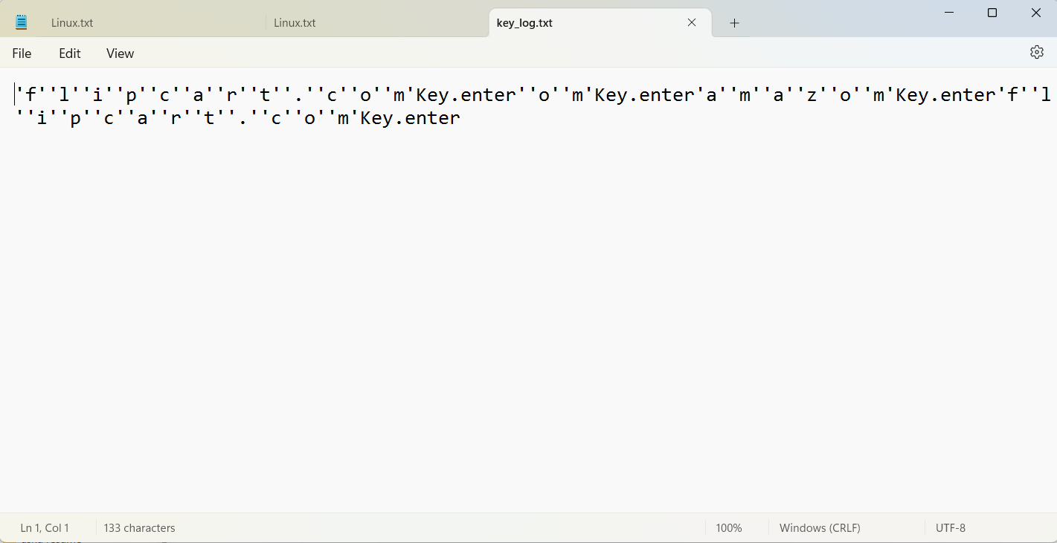
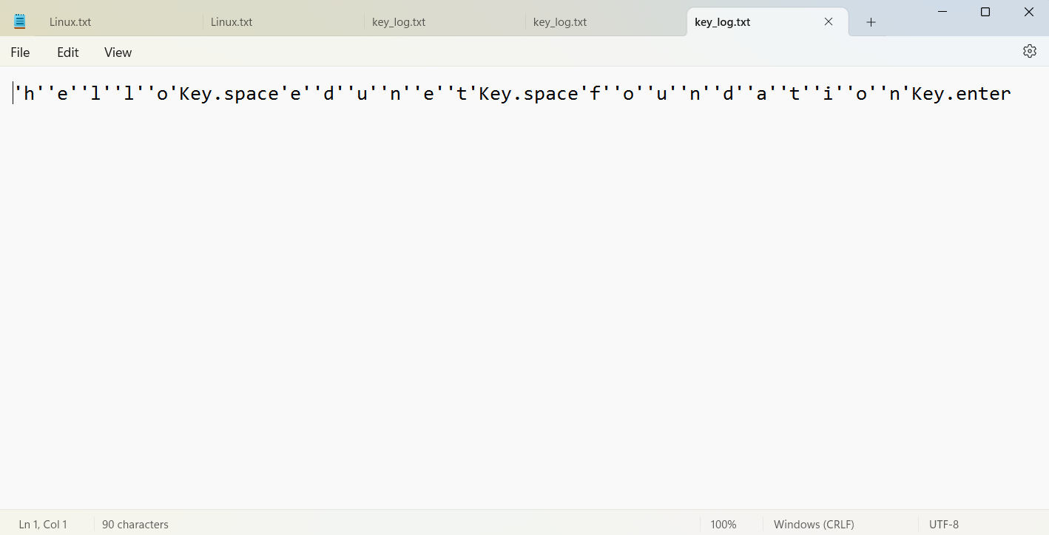
RESULT

